Slide 1
Major Project Presentation on Loan Prediction Model Presented by Ayush Nigam (0105CS141022)

Slide 2
Organization of Presentation
Introduction
Objectives
Software Requirement Specification(SRS) (Functional Requirements)
Software Requirement Specification(SRS) (Non-Functional Requirements)
Software and Hardware Requirements
Design Diagrams
Screen Layouts with Description
Conclusion and Future Scope

Slide 3
Introduction
The loan predictor model is used by the banking sector to reduce the time overhead in the decision-making capability of the organization by analysing the credentials of the applicant.

Slide 4
Objectives
To refine the data set and make it suitable to create the model.
To create a predictive model that has a minimum of 80% accuracy.
To create a model that can predict the whether the loan of the applicant can be approved or not.

Slide 5
Software Requirement Specifications (Functional requirements)
Data refinement should be done properly while reading data from the dataset
Relevant variables should be selected for model creation
Model should be robust in nature
Accuracy in the prediction should be at least 80%

Slide 6
Software Requirement Specifications (Non - Functional requirements)
Secure
Easily Usable
Robustness
Easily Maintainable
Testable
Scalable
Accuracy of the results

Slide 7
Software and Hardware Requirements (Software Requirements)
Operating System: Windows 8/Linux/Macintosh
Front End Tool: Jupyter, R language
Back End Tools : R and Python Kernel
StarUml tool for diagram design
Browser: Edge

Slide 8
Software and Hardware Requirements (Hardware Requirements)
CPU : 32x or 64x architecture with minimum clock speed of 1 Gigahertz
RAM : Minimum 2 GHz
HDD : Minimum 15 GB
Monitor : Coloured

Slide 9
Design Diagrams
Flow Chart
ER Diagram
Class Diagram
Data Flow Diagram
State Transition Diagram
Activity Diagram

Slide 10
Design (Flow-Chart)

Slide 11
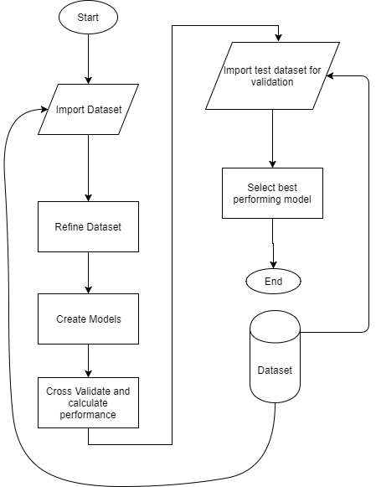

Slide 12
Design (ER Diagram)

Slide 13
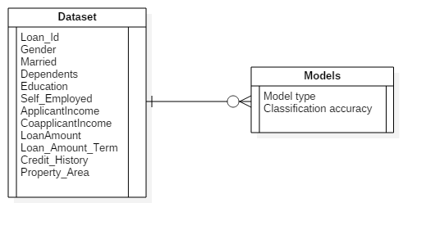

Slide 14
Design (Class Diagram)

Slide 15
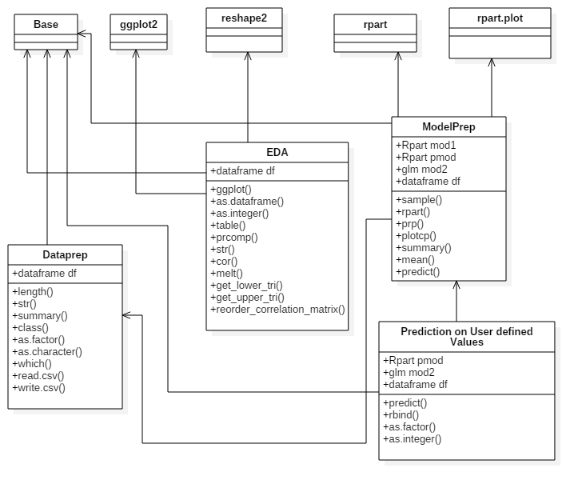

Slide 16
Design (Data Flow Diagram)

Slide 17
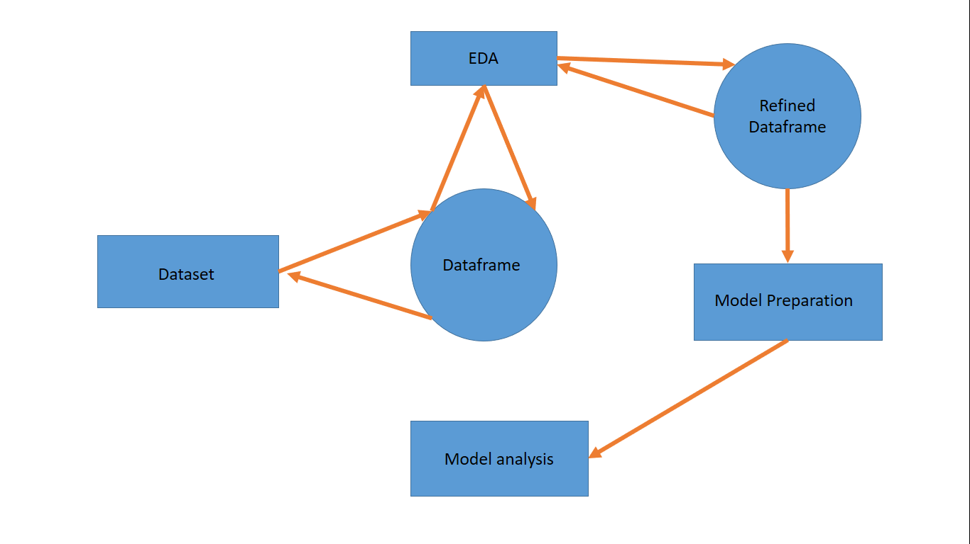

Slide 18
Design (State Transition Diagram)

Slide 19
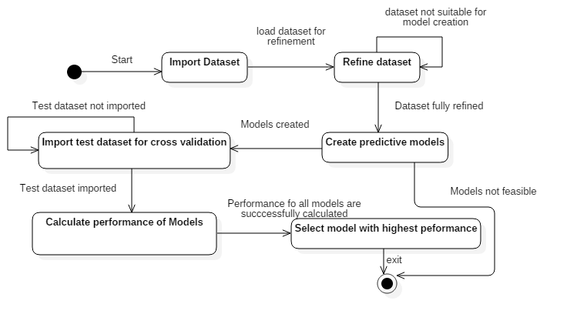

Slide 20
Design (Activity Diagram)

Slide 21
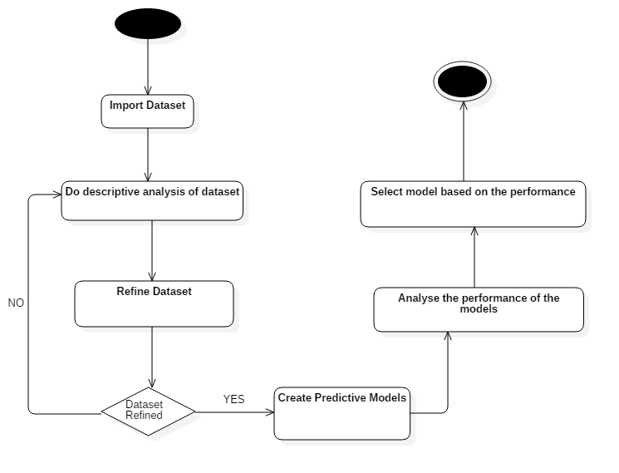

Slide 22
Screen Layouts
EDA.ipynb
ModelPrep.ipynb
Prediction on User defined Values.ipynb

Slide 23
Screen Layouts EDA.ipynb

Slide 24
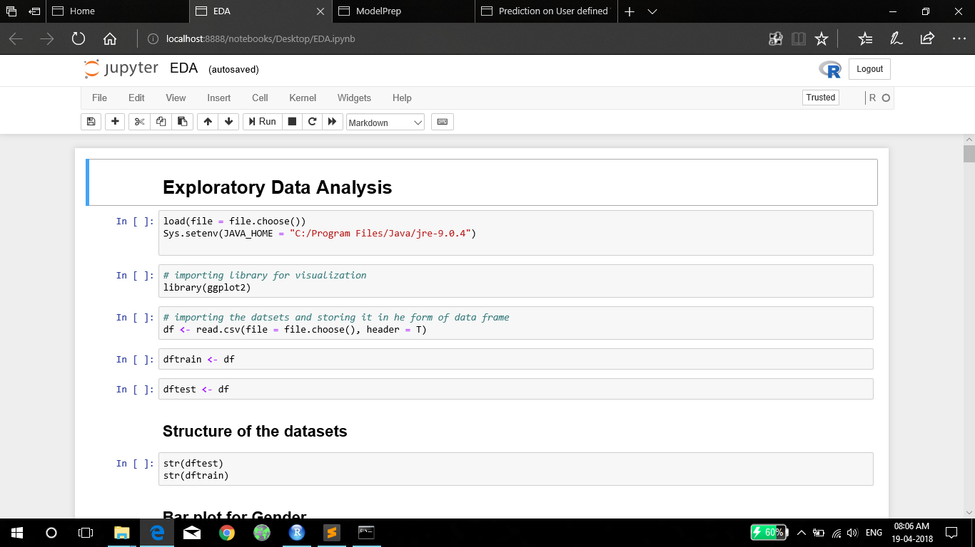

Slide 25
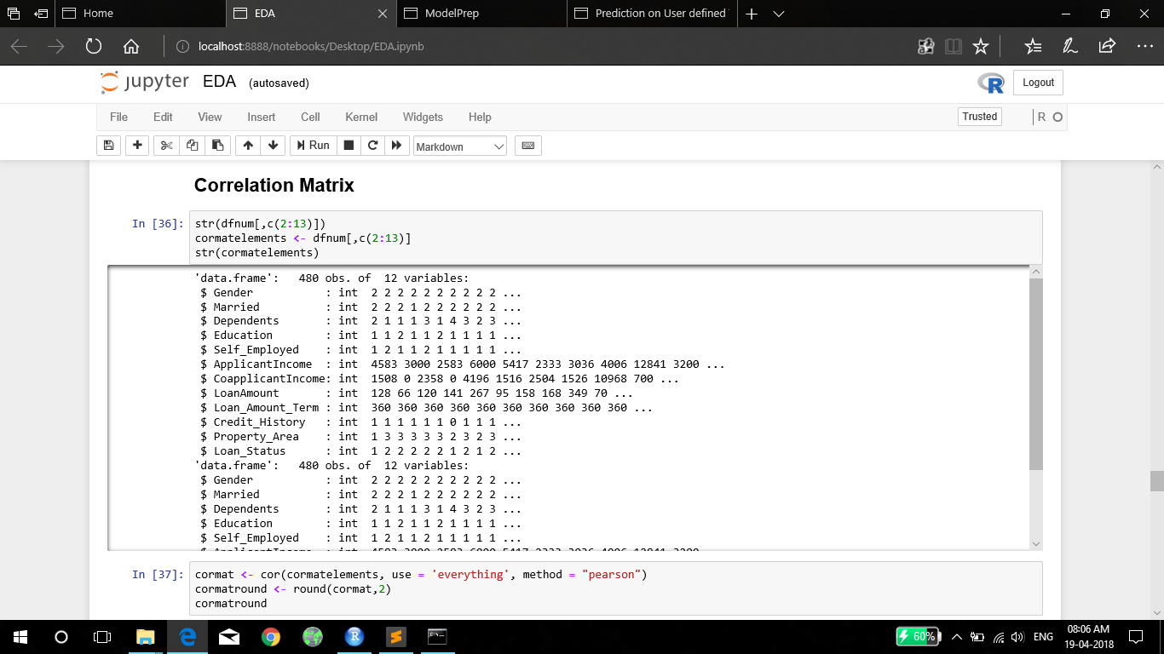

Slide 26
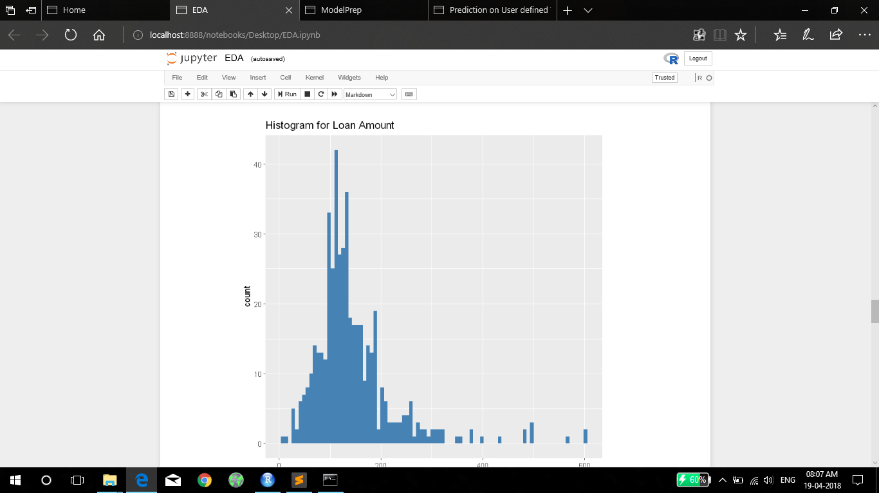

Slide 27
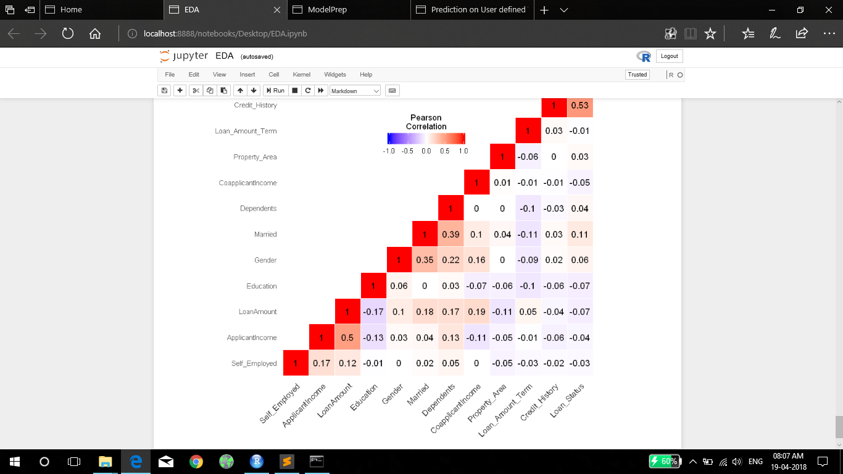

Slide 28
Screen Layouts ModelPrep.ipynb

Slide 29
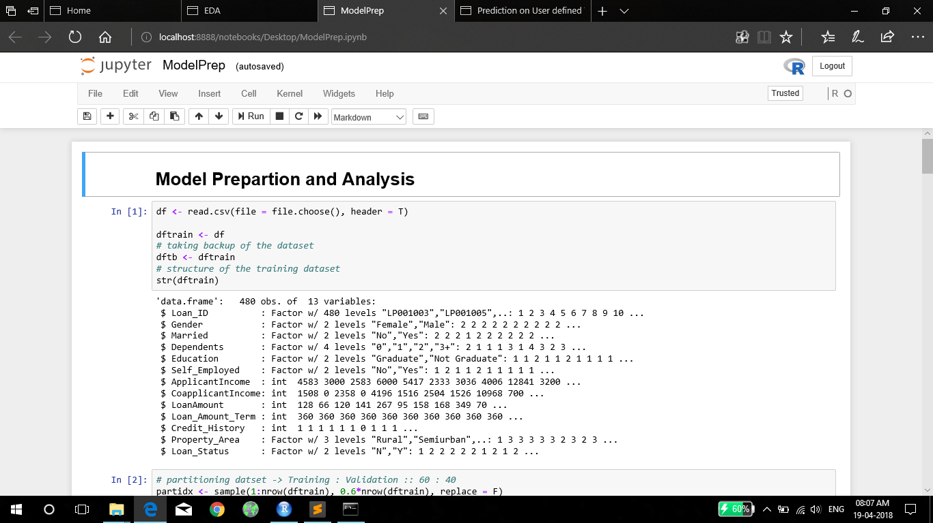

Slide 30
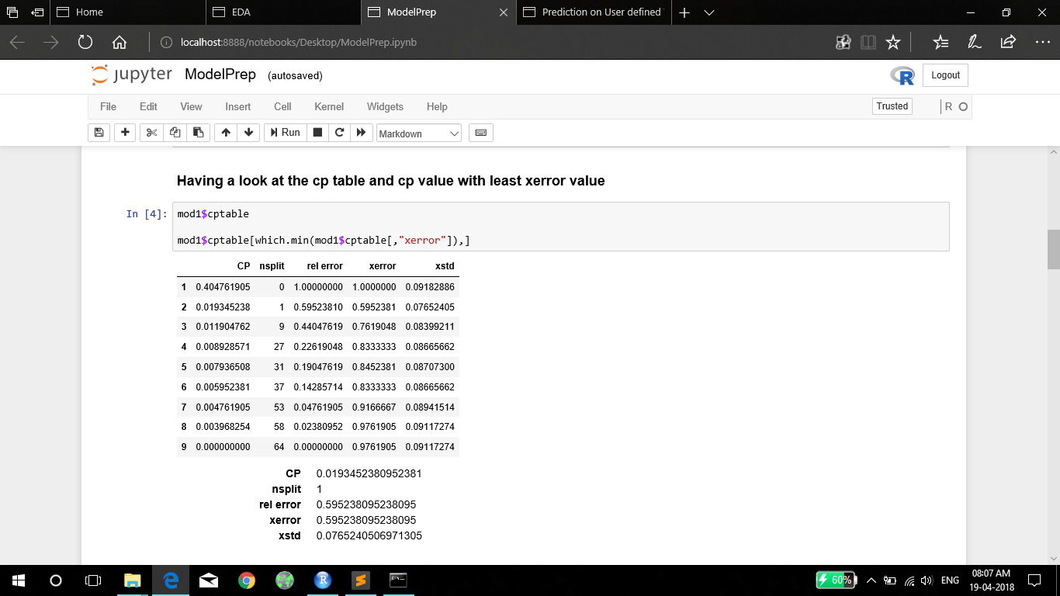

Slide 31
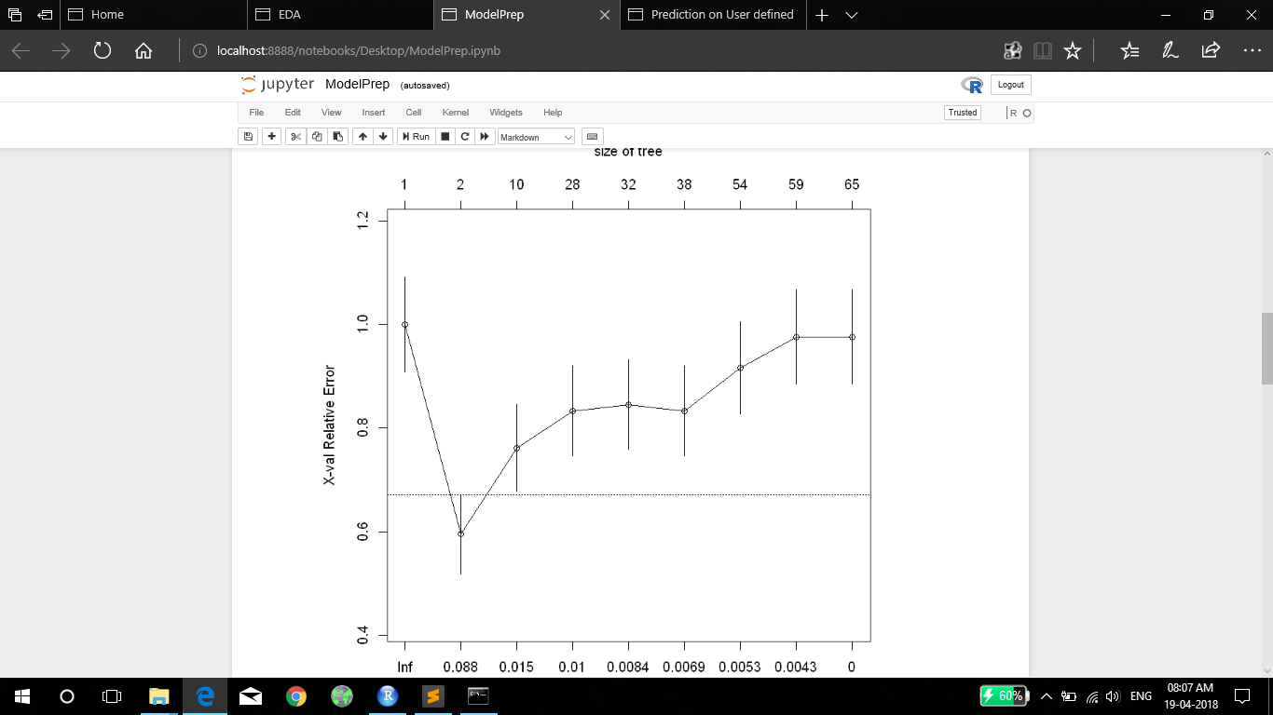

Slide 32
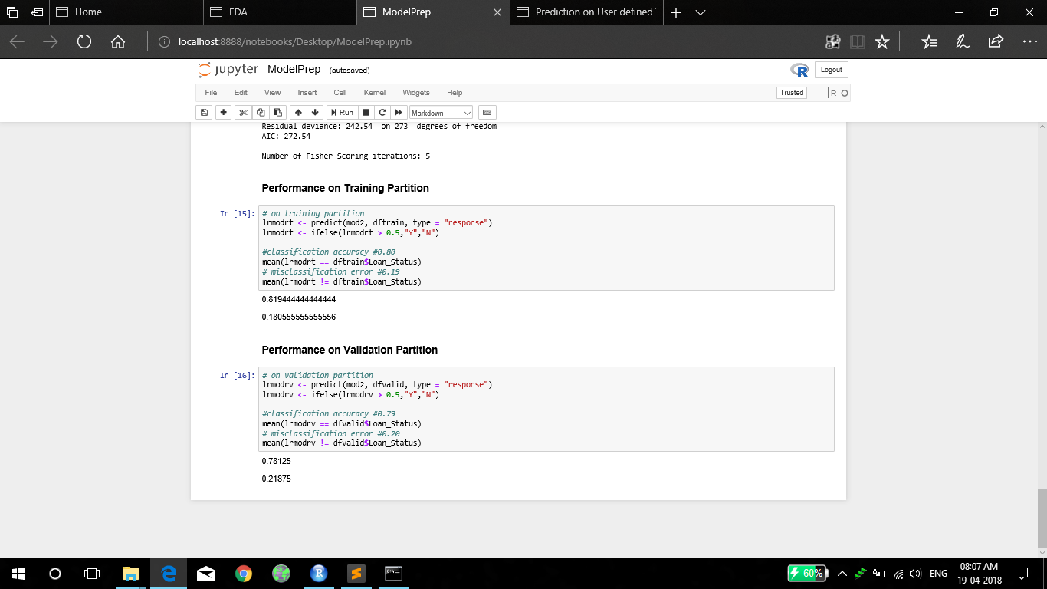

Slide 33
Screen Layouts Prediction on User defined Values.ipynb

Slide 34
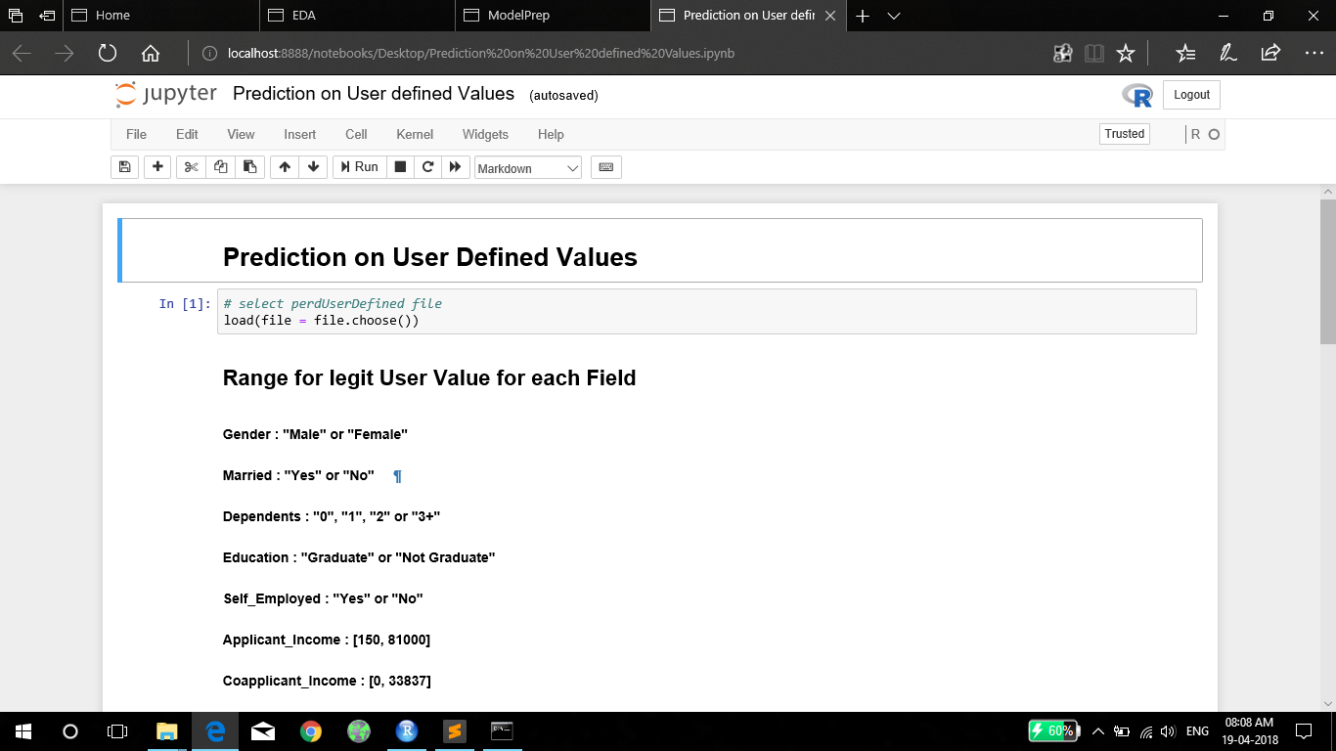

Slide 35
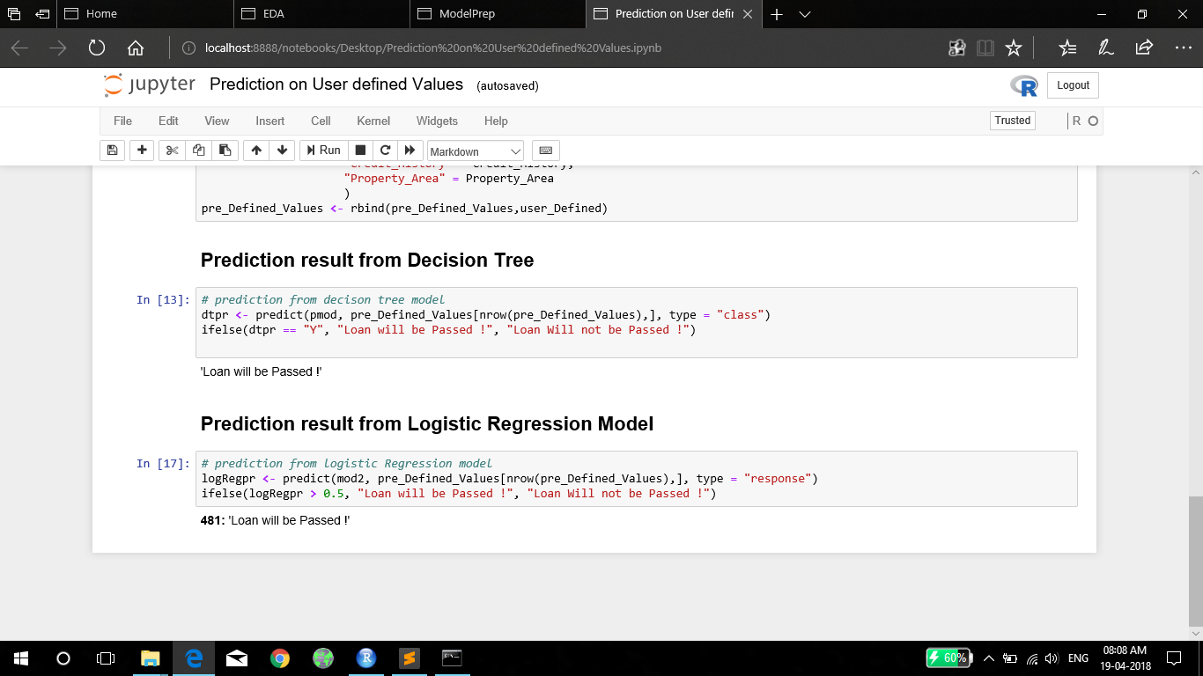

Slide 36
Conclusion
The idea of predictive modelling in order to determine the output based on certain parameters as input is intriguing and challenging at the same time. For one to complete such a task, both soundness in mathematical concepts as well as in programming language. Hence, it offers a great learning experience. Also the paradigm shift towards automation in the current trend one gets to experience a part of automation through this project and acts as icing in the cake.
It certainly has a lot future scope because of it’s capabilities.

